Slide 1
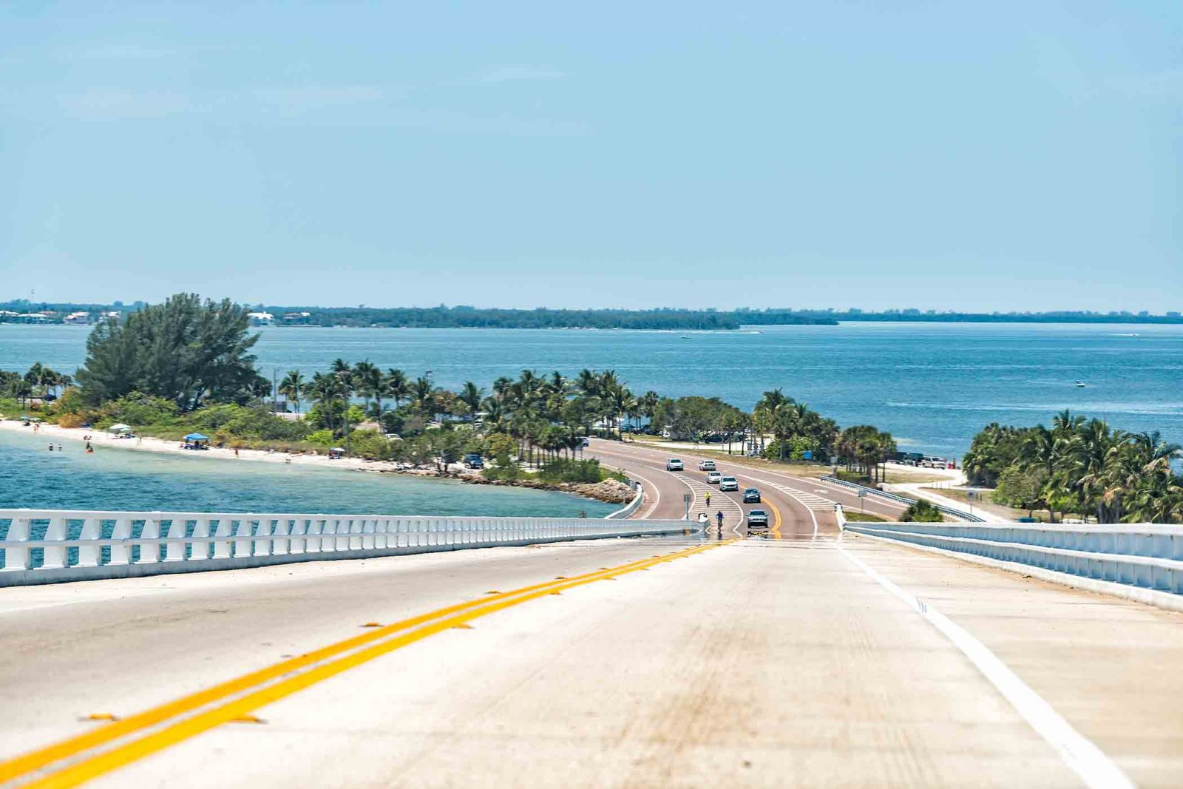

Sanibel Causeway Islands Improvements
Jesse Lavender
Director, Lee County Parks & Recreation
Lee Board of County Commissioners
Workshop – February 1, 2022

Slide 2
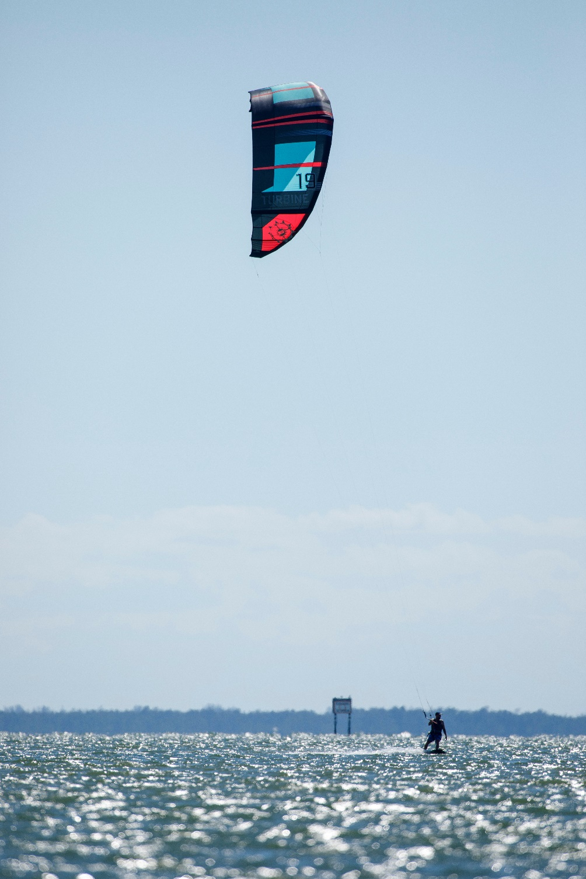

AGENDA
Question
Timeline
Project Review
Board & Public Input
Next Steps
Question
Lee Board of County Commissioners | Workshop 2/1/22

Slide 3
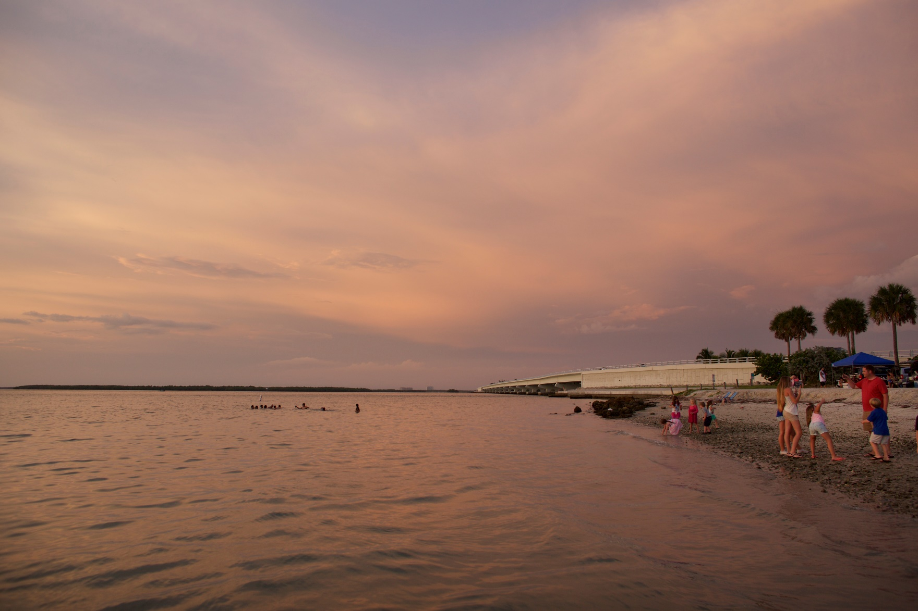
QUESTION
Do you want to see traditional beach amenities?
  Lynn Hall, Bowditch Beach, Bonita Beach
  Pavilions, Picnic Areas, Restrooms, Designated Parking, Paid Parking
Lee Board of County Commissioners | Workshop 2/1/22

Slide 4
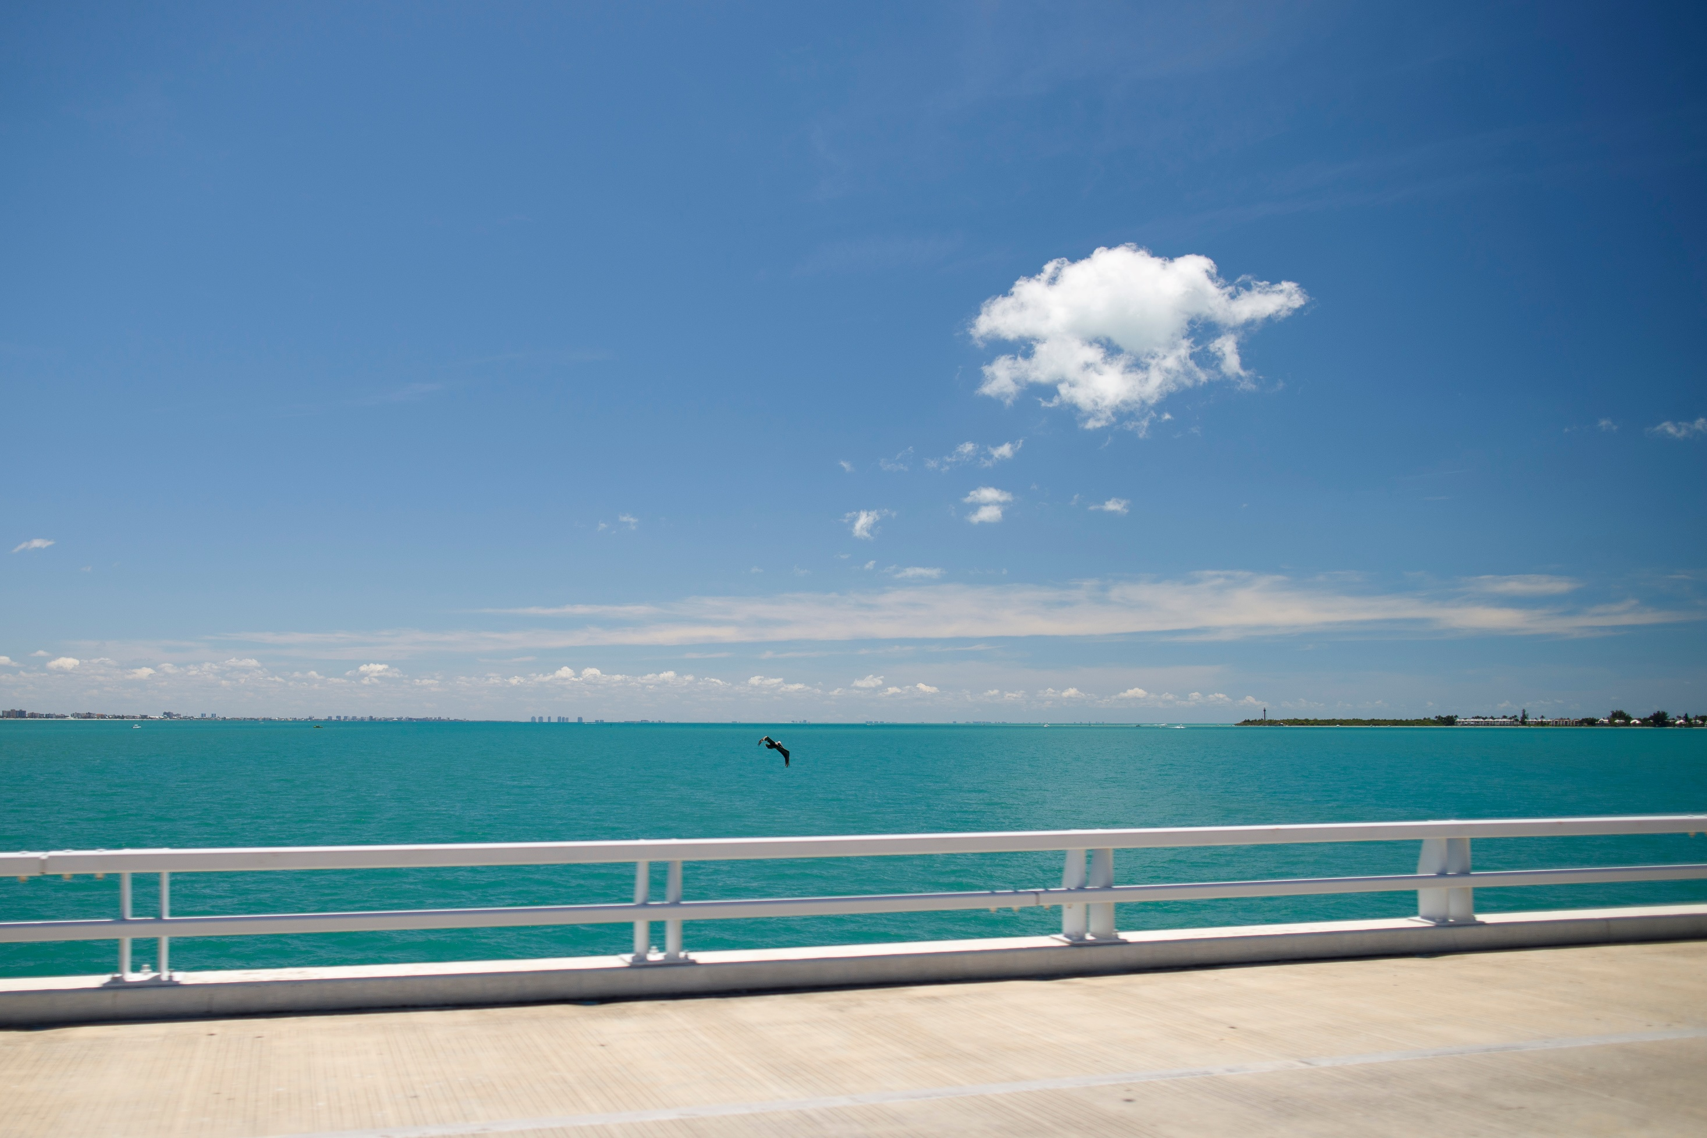
TIMELINE
2014
February 2017
July 2020
November 2020
December 2020
STA issued to develop Sanibel Causeway Center Island Shoreline Stabilization Conceptual Planning Study (Island B)
BoCC Approves $1.85M TDT Funds for Project
State Legislative Appropriation of $4.25M for Project
Board Approves $2.4M TDT Funds for Project
BoCC Vote Expands Project to Include Upland Improvements
State Funding Agreement Requires Project Completion by
June 30, 2024
Lee Board of County Commissioners | Workshop 2/1/22

Slide 5
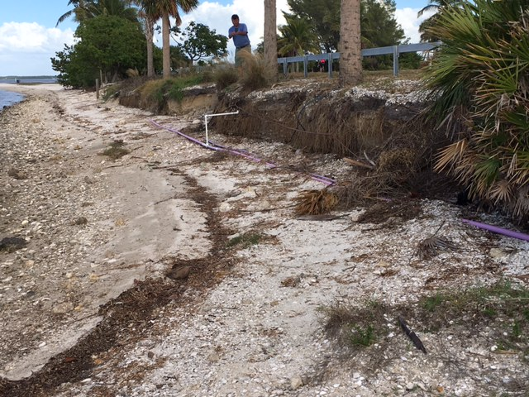
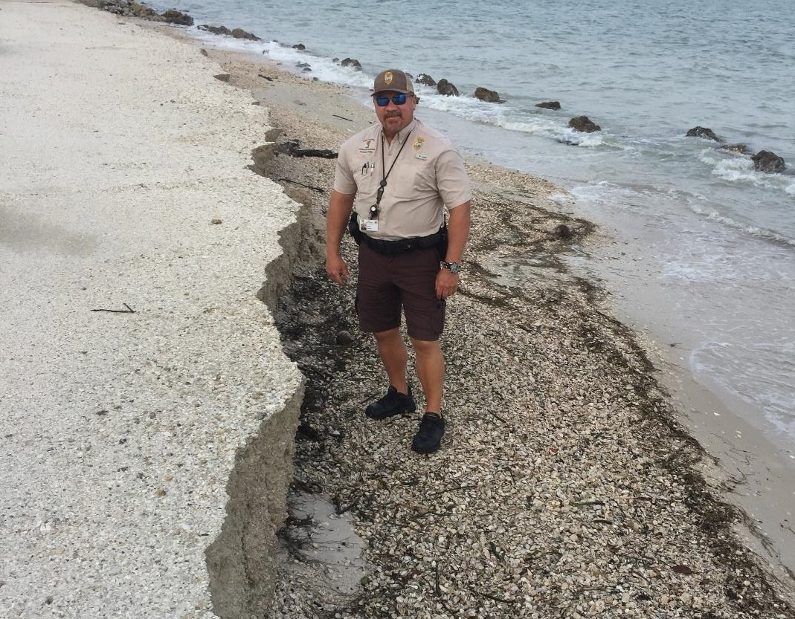

PROJECT HISTORY
PHASE I
2016
Island B Shoreline Stabilization
Control erosion caused by roadway runoff & wave action
Exacerbated by storm events
Fixes include adding fill & hardening sections
Lee Board of County Commissioners | Workshop 2/1/22

Slide 6
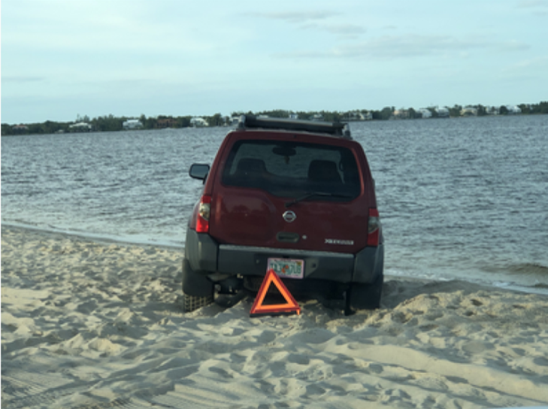
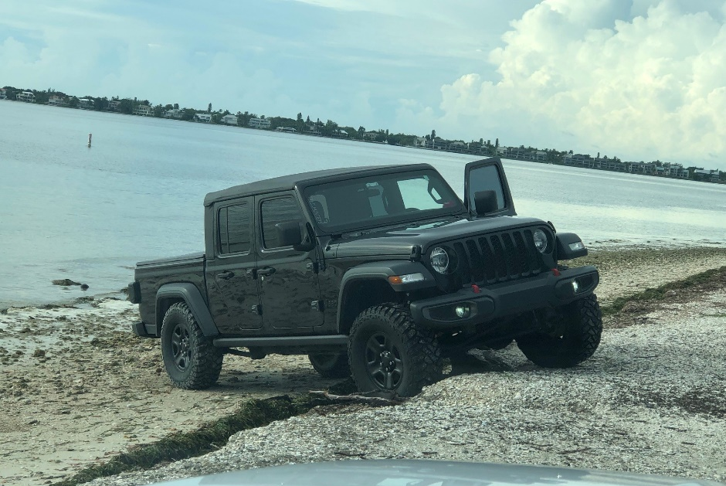
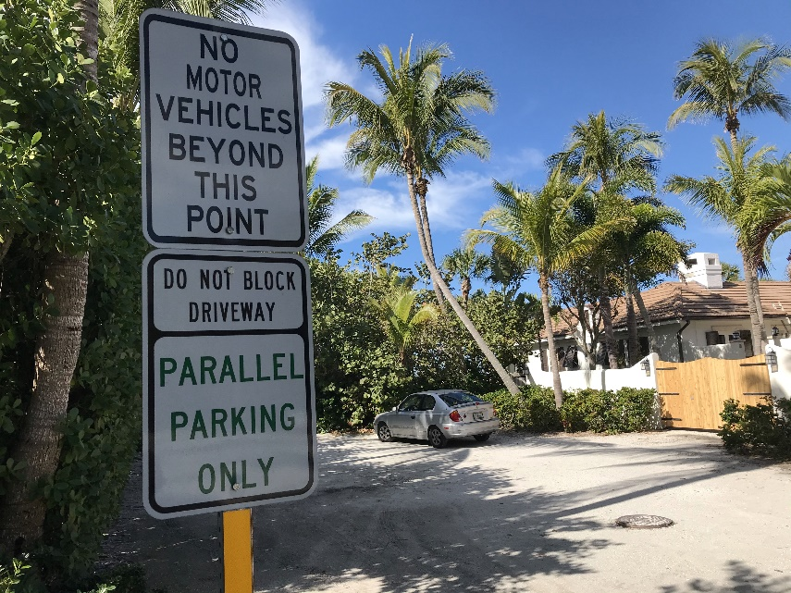
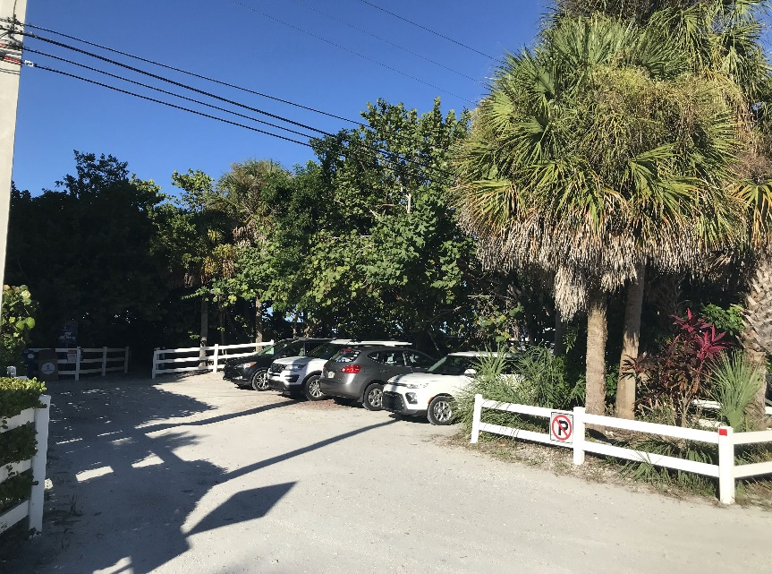

PROJECT HISTORY
No Designated Parking
PHASE II
Additional water retention areas
Designated parking & other safety improvements
More shoreline erosion control
Need for restrooms
Designated Parking
Lee Board of County Commissioners | Workshop 2/1/22

Slide 7
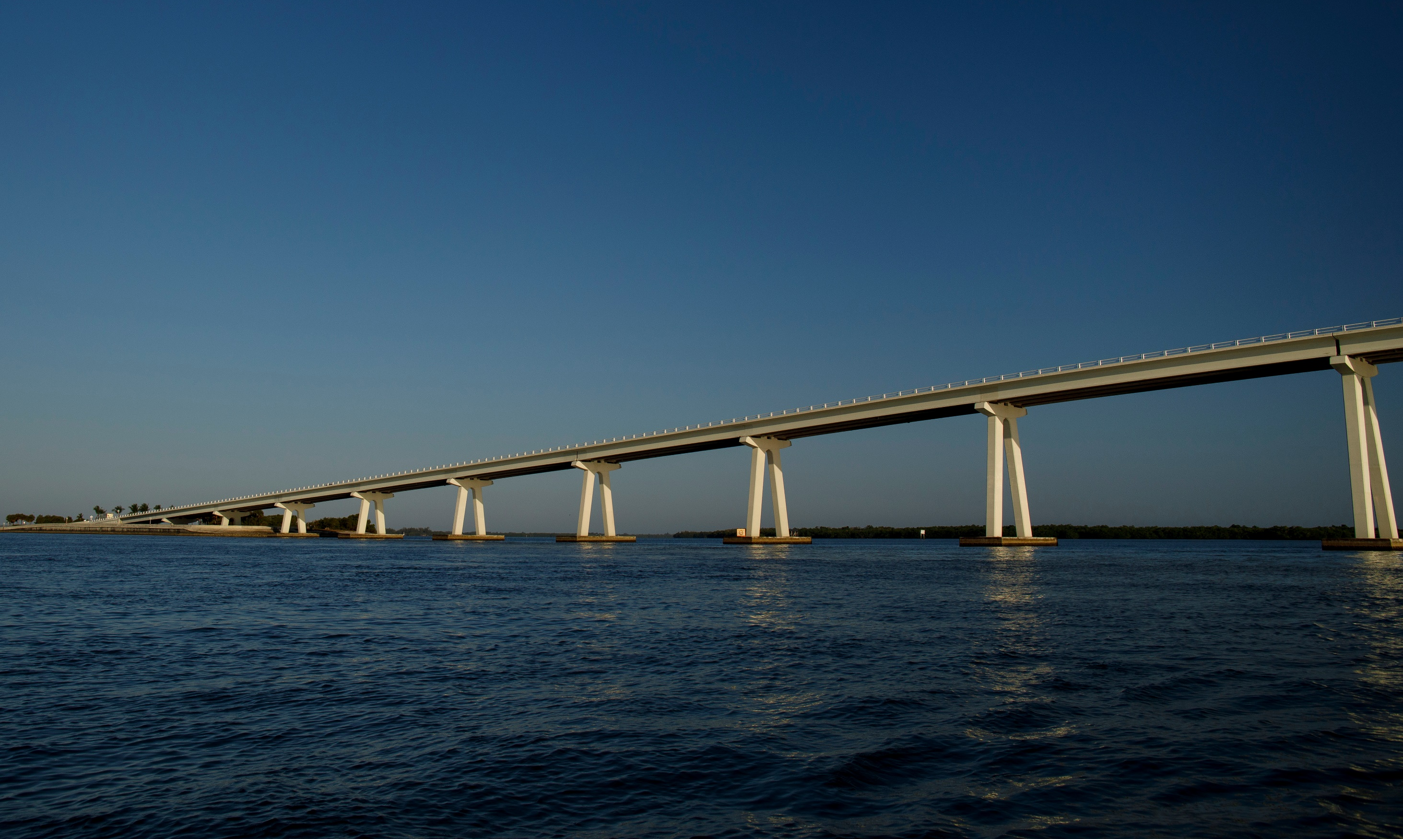
PUBLIC INPUT
May 2021
Received preliminary site plans from consultant
Plans included feedback from the public gathered since 2015
8/23/2021
Meeting with City of Sanibel staff
8/26/2021
Public meeting at Wa-Ke Hatchee Recreation Center
10/6/2021
Presentation to Sanibel Chamber of Commerce
Public Input Received to Date
Additional Restrooms
Personal Non-Motorized Watercraft Landings/Launching
Native Landscaping
Outdoor Showers
Designated Parking
More Shade or Shelters
Fish Cleaning Station
Paid Parking
Lee Board of County Commissioners | Workshop 2/1/22

Slide 8
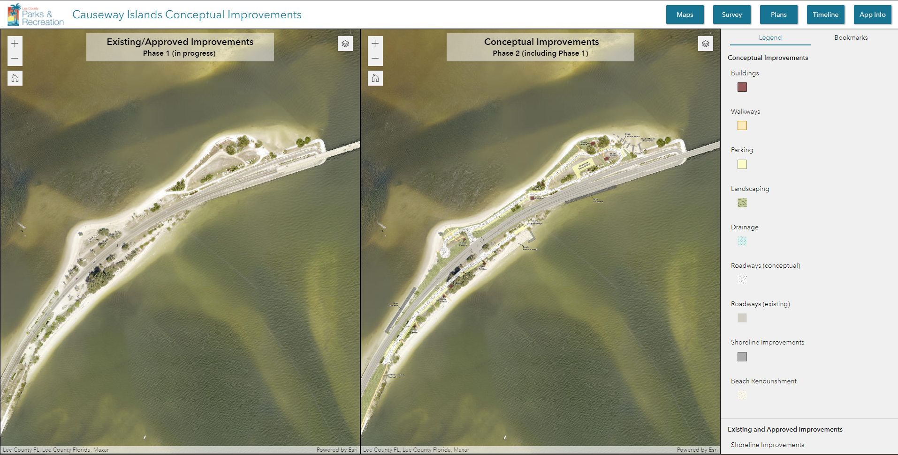
Lee Board of County Commissioners | Workshop 2/1/22

Slide 9
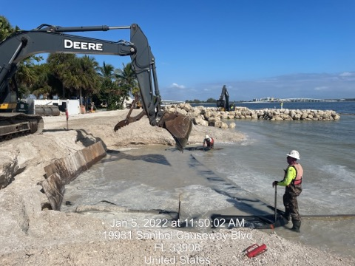
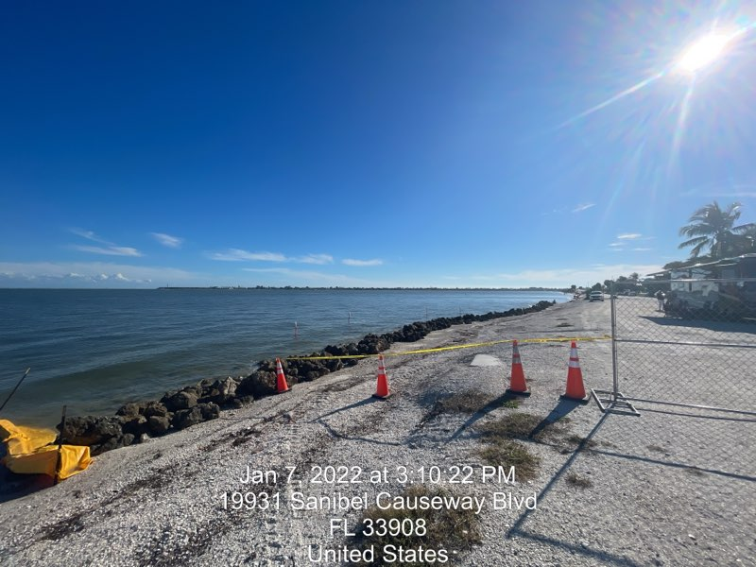
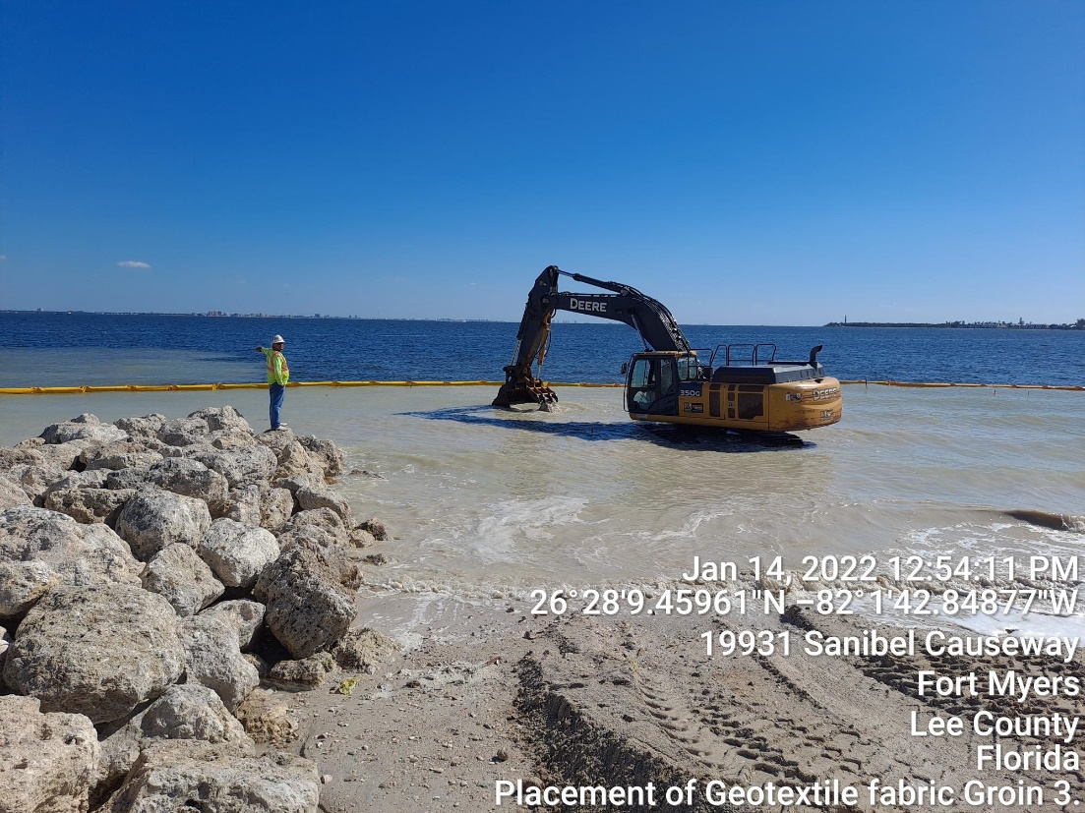
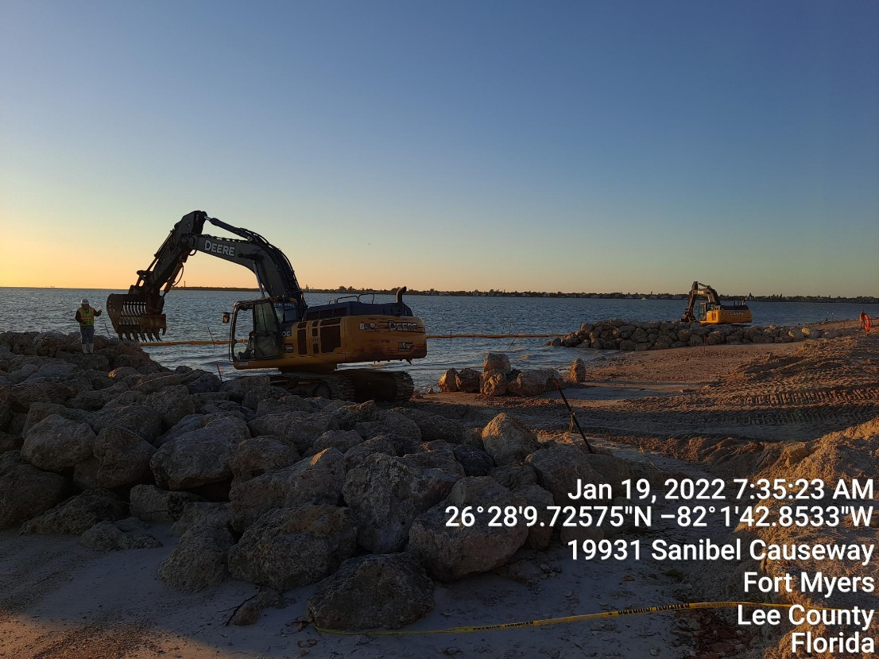
NEXT STEPS
PRELIMINARY PLANS
Island A
234 standard parking spaces
4 RV spaces
Island B
214 standard parking spaces
Lee Board of County Commissioners | Workshop 2/1/22

Slide 10
QUESTION
Do you want to see traditional beach amenities?
  Lynn Hall, Bowditch Beach, Bonita Beach
  Pavilions, Picnic Areas, Restrooms, Designated Parking, Paid Parking
Lee Board of County Commissioners | Workshop 2/1/22

